Slide 1
Comic Book SeARCH
Gabrielle Byers Tanner Millican
Aldo Salinas FelIpE Cantu

Slide 2

The Problem
Lack of site to search for all comic books in one place, regardless of universe (Marvel, DC, etc.)
Difficulty buying older issues

Slide 3
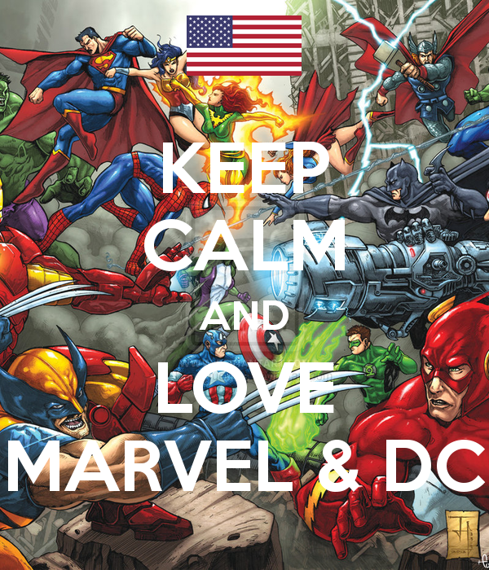
The SOLUTION
Create a universe-agnostic site
Enable search functionality for any comic character
Provide quick links to eBay listings for each result

Slide 4
Minimum viable product
Target audience/users: Comic book lovers
User Stories:
As a user,
As a user,
As a user

Slide 5


The APPROACH
Used to build solution:
Capture user search Input
Return results from Comicvine API
Return link to each result using eBay API

Slide 6

New technologies:
Materialized:
A modern responsive front-end framework based on Material Design

Slide 7
Demo

Slide 8
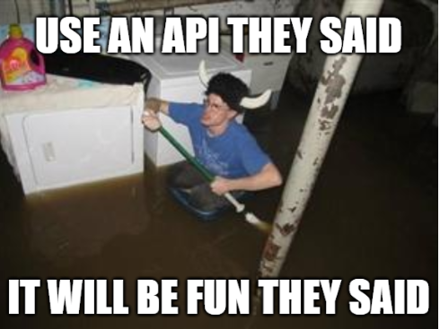
challenges

Slide 9
What’s next
Expand search capabilities:
Issue number, volume, number, story arc, etc.
Wishlist functionality
Track purchases to create “library”
Display general character information and suggest books

